Slide 1
Sports Analytics & Community Engagement
library(dplyr)
rladies_global %>%
filter(city == ’Melbourne')

Slide 2
A Big Thank you to our amazing and faithful sponsor

Slide 3
When: Monday 3rd & Tuesday 4th July, 9am-5pm
Where: Arts West, Melbourne Uni Campus
Send your expression of interest here

Slide 4
Community Engagement

Slide 5
Hello!
I am Lyndal Henden I am here because I love maths, R and community engagement. I am an ambassador for ChooseMaths. You can find me at @LyndalHenden.

Slide 6
Sports Analytics With R

Slide 7
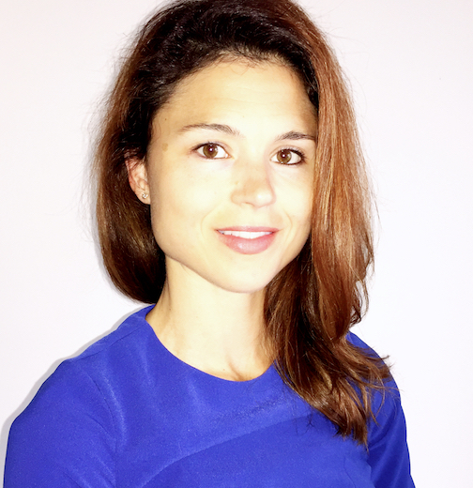
Hello!
I am Stephanie Kovalchik I am here because I love tennis and R. I write a blog called Stats on the T. You can find me at @StatsOnTheT.

Slide 8
A Big Thank you to our amazing and faithful sponsor

Slide 9
As Obi-Wan Kenobi may have said in Star Wars: “Use the source, Luke!"
—Barry Rowlingson
(answering a question on the documentation of some implementation details) R-devel (January 2010)

Slide 10
This is a
slide title
Here you have a list of items
And some text

Slide 11
BIG CONCEPT

Slide 12
You can also split your content
White
Is the color of fresh snow.
Purple
Is the color of purple.

Slide 13
In two or three columns
Column 1
First column.
Column 2
Second column.
Column 3
Third column.

Slide 14
This is how your charts could look
Purple
White
Purple

Slide 15
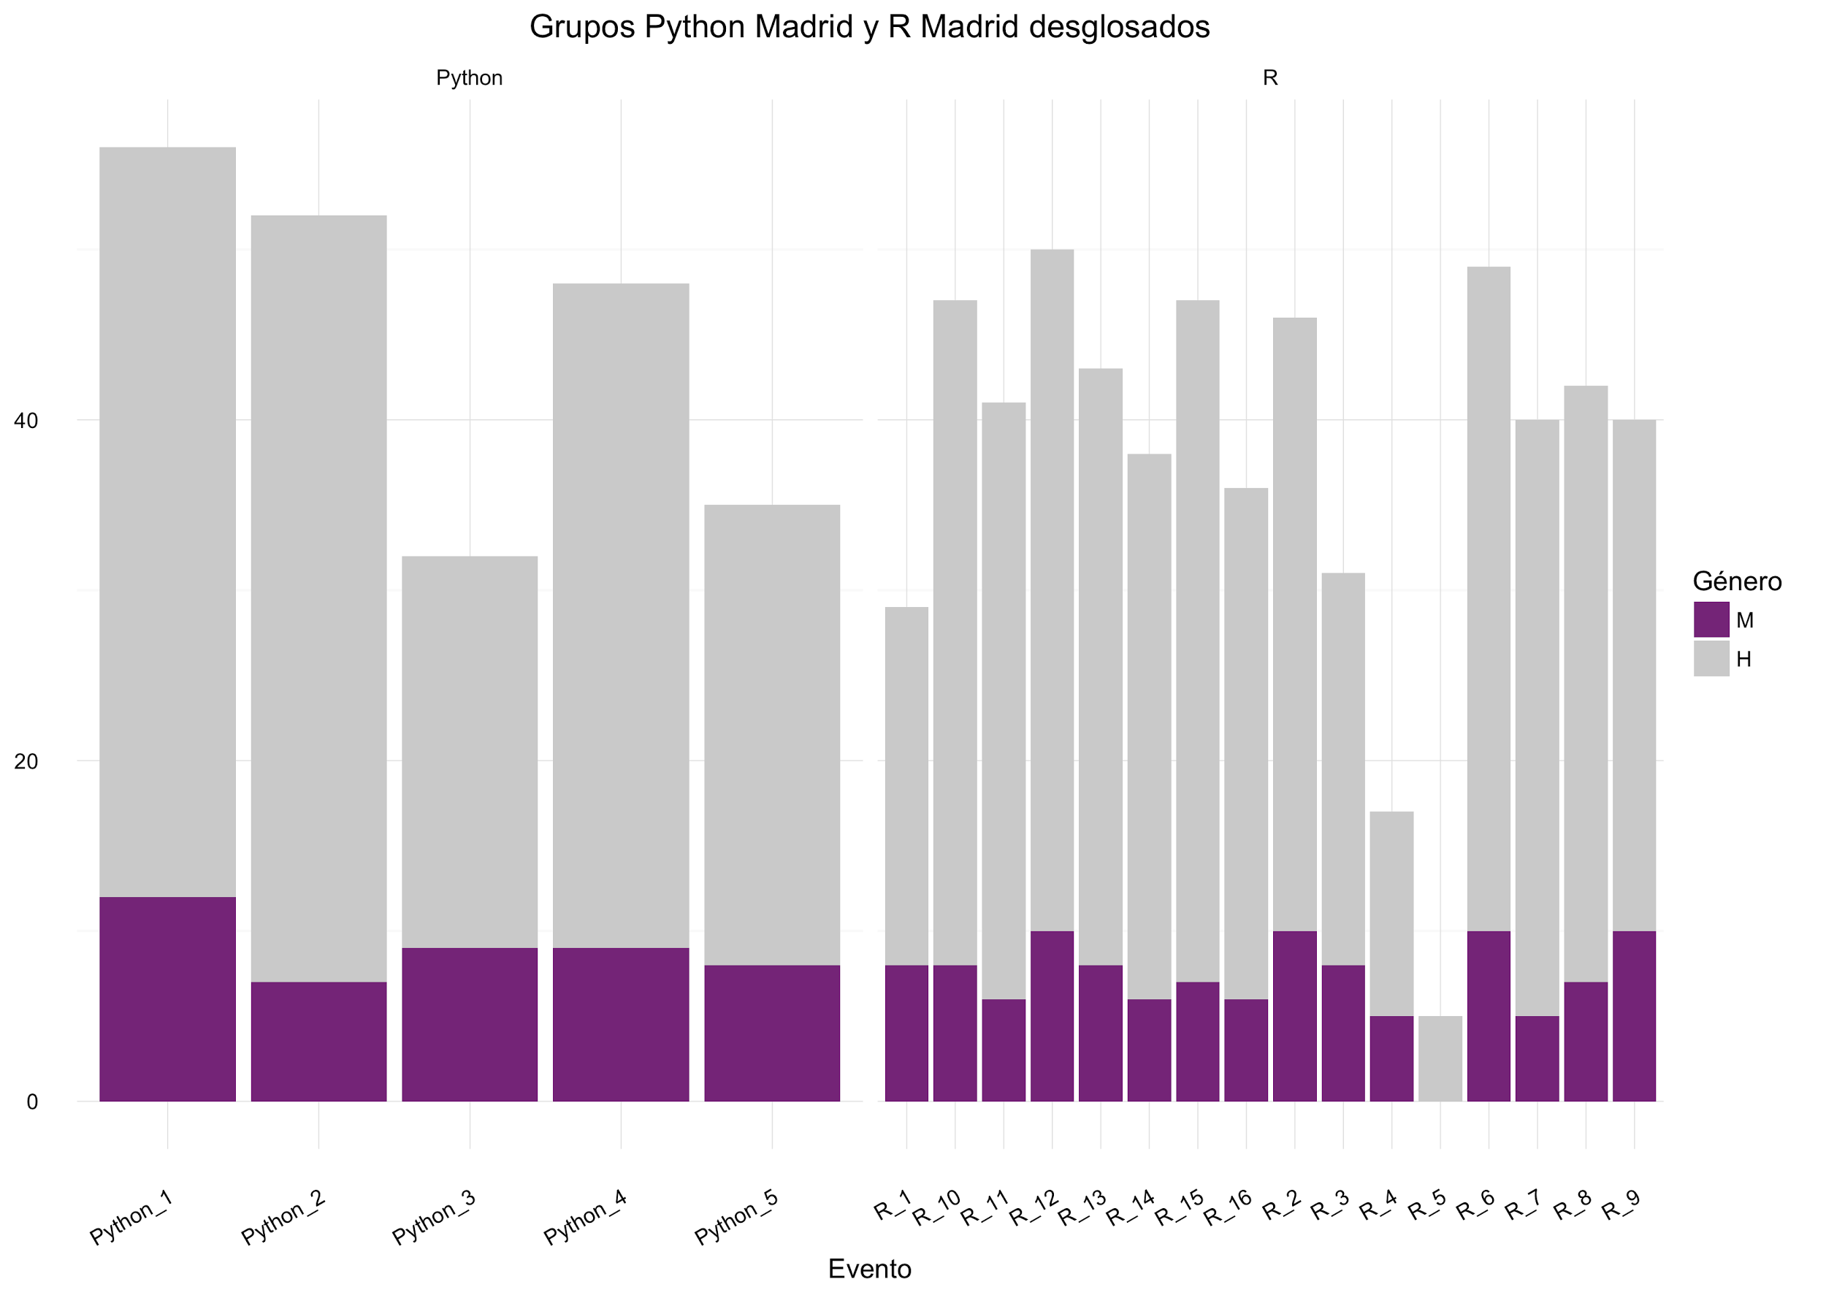
Or with ggplot2
Well, this one is a bit ugly but you get the idea.

Slide 16
89,526,124$
185,244 users
100%
That’s a lot of money
And a lot of users
Total success!

Slide 17
Our process
is easy
first
second
last

Slide 18
SlidesCarnival icons are editable shapes.
This means that you can:
Resize them without losing quality.
Change line color, width and style.
Isn’t that nice? :)

Slide 19
😉
Now you can use any emoji as an icon!
And of course it resizes without losing quality and you can change the color.
How? Follow Google instructions https://twitter.com/googledocs/status/730087240156643328
✋👆👉👍👤👦👧👨👩👪💃🏃💑❤😂😉😋😒😭👶😸🐟🍒🍔💣📌📖🔨🎃🎈🎨🏈🏰🌏🔌🔑

